Slide 1
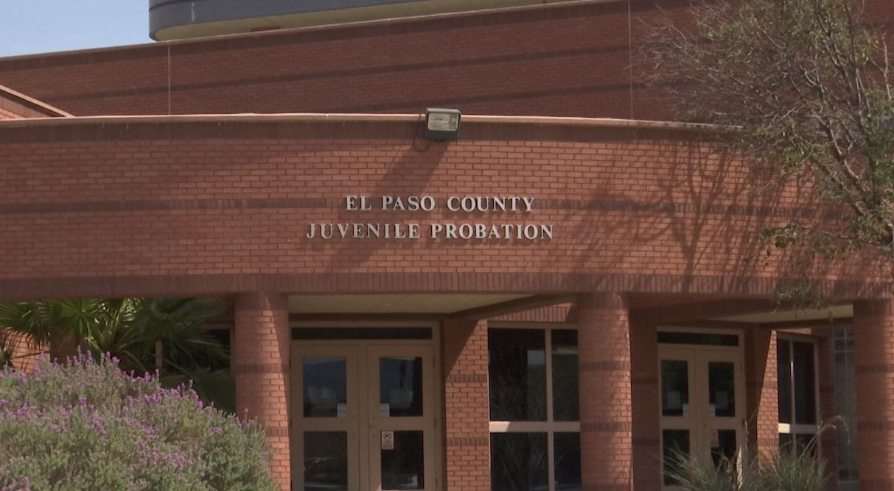
Delta Academy
El Paso Independent School District
6400 Delta Dr.
El Paso, TX 79905
Phone: (915) 236-8975

Slide 2
DELTA ACADEMY COUNSELING DEPARTMENT:
Michael Anaya, Counselor
Phone: (915) 236-8986
Email: meanaya1@episd.org

Slide 4
Foundation Plan
Distinguished Achievement
26 Credits (required for graduation in the state of Texas)
English: 4 credits
Math: 4 credits
Science: 4 credits
Social Studies: 3 credits
Foreign Language: 2 credits
PE: 1 credit
Fine Arts: 1 credit
CTE: 1 credit
Health: 0.5 credit
Speech: 0.5 credit
Endorsement: 4 credits
Elective: 1 credit

Slide 6
FAFSA Completion Requirement:
The Texas Education Code states that: “Before graduating from high school, each student must complete and submit a free application for federal student aid (FAFSA) OR a Texas application for state financial aid (TASFA)”.

Slide 7
CCMR: College, Career, Military Readiness
How do I meet the CCMR standards? (multiple options)
-TSI College Ready Benchmark Scores in Math & Reading/Writing
-SAT/ACT College Ready Benchmark Scores
-AP/IB College Ready Benchmark Scores
-Enroll & Pass both semesters of College Math & College English with an overall 75 average per semester and a minimum score of 60 on the final exams
-Successfully complete required hours in Dual Credit
-Earn industry certification
-Intent to enroll in the US Armed Forces
-Graduate with completed IEP and workforce readiness
*Each student must meet CCMR standards in Math & Reading/Writing upon graduation-

Slide 8
Community Resources & Support

Slide 9
